Slide 1

WELCOME TO OUR ENGLISH CLASS !

Slide 2
UNIT 8: PLACES
Section A
Asking the way (A1, A2, A3)
(text book / page 79-82)

Slide 3


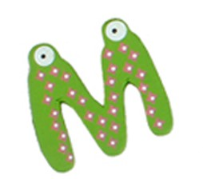

JUMBLED WORDS
LOHOSC ⮚ SCHOOL

Slide 4
JUMBLED WORDS
K
A
B
N
BANK
S
I
N
A
T
O
T
STATION
H
E
L
O
T
HOTEL
K
A
T
M
E
R
MARKET
L
O
H
I
T
A
P
S
HOSPITAL
T
I
C
O
T
F
E
F
S
P
POST OFFICE

Slide 5
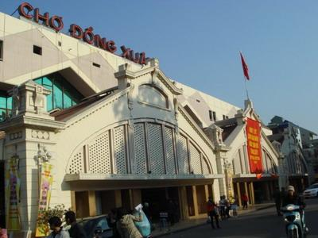
A1. Name the places:

Slide 6
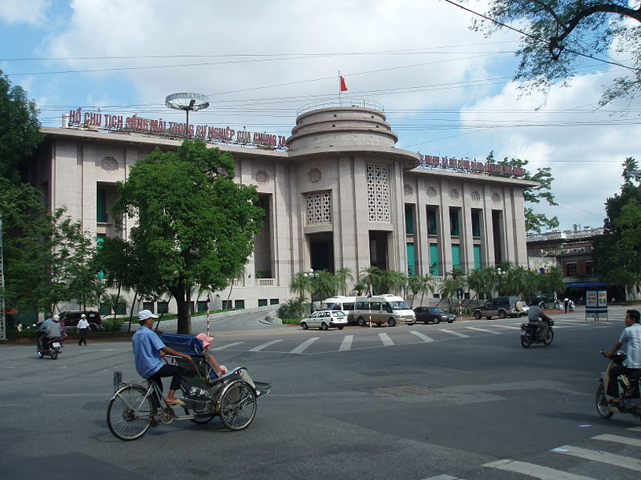

Slide 7
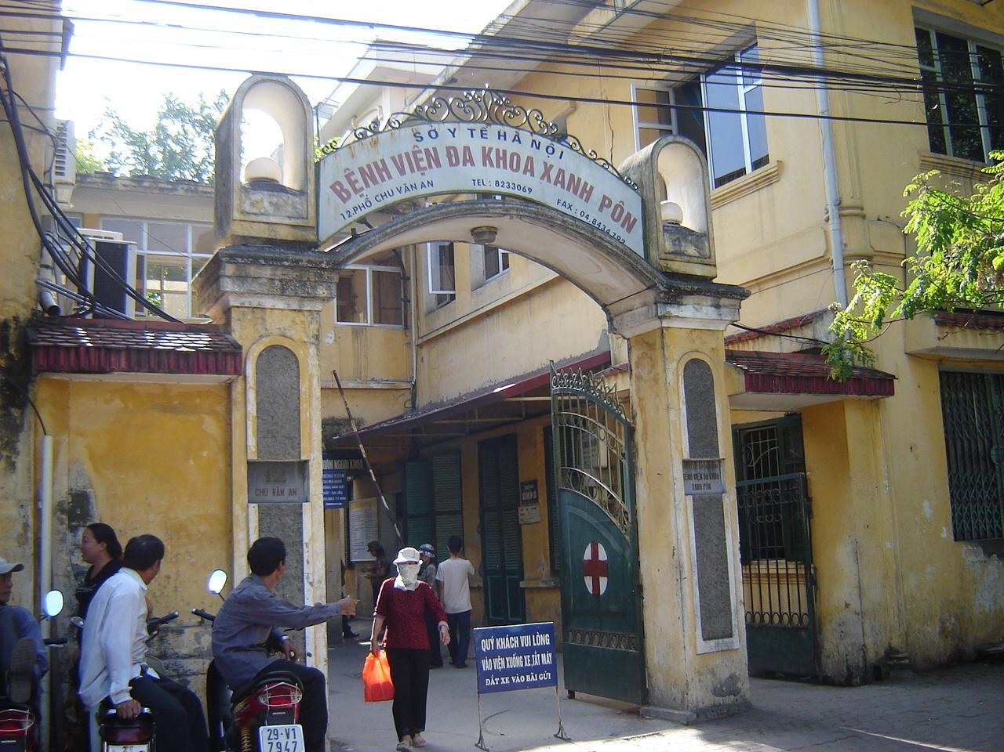

Slide 8
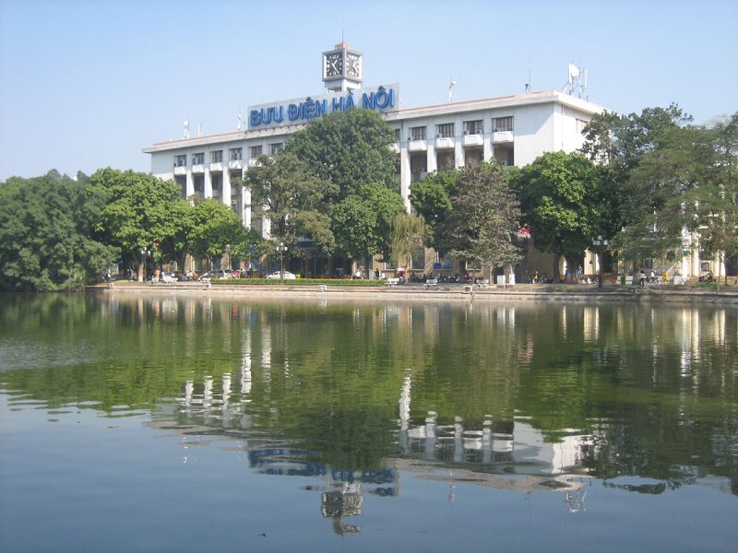

Slide 9
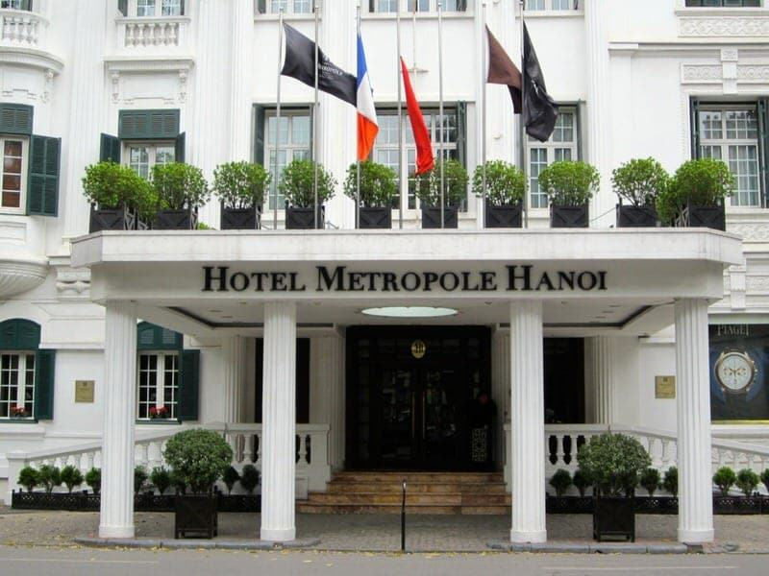

Slide 10
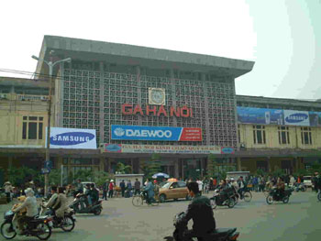

Slide 11
Matching :
1. Dong Xuan market
Picture 1
Picture 4
2. Sofitel Metropole Hotel
3. National Bank of VN
Picture 2
4. Saint Paul Hospital
Picture 5
5. The Central Post Office
6. Ha Noi Railway Station
Picture 3
Picture 6

Slide 12

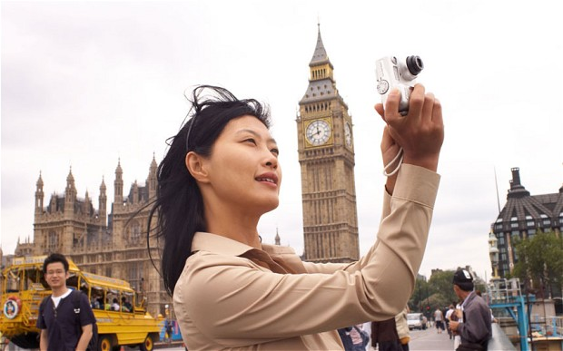
New words
tourist (n)
khách du lịch

Slide 13

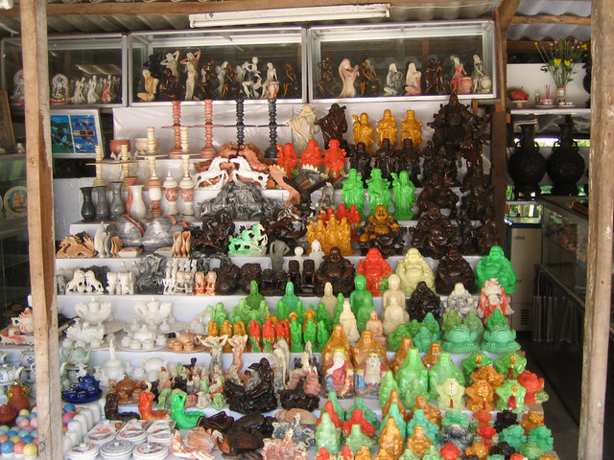

New words
souvenir shop (n)
cửa hàng bán đồ lưu niệm
go straight ahead
đi thẳng
BAKERY
HOSPITAL
RESTAURANT
FACTORY
TOY STORE
SUPERMARKET
BANK
SHOE STORE
MOVIE THEATER
DRUGSTORE
RESTAURANT
HOTEL
PARK
MARKET
SOUVENIR SHOP
POST OFFICE
STADIUM
POLICE STATION
SCHOOL
BOOKSTORE
MUSEUM

Slide 14

New words
take the first street:
rẽ ở con đường thứ nhất
BAKERY
HOSPITAL
RESTAURANT
FACTORY
TOY STORE
SUPERMARKET
BANK
SHOE STORE
MOVIE THEATER
DRUGSTORE
RESTAURANT
HOTEL
PARK
the third street
the first street
the second street
MARKET
SOUVENIR SHOP
POST OFFICE
STADIUM
POLICE STATION
SCHOOL
BOOKSTORE
MUSEUM

Slide 15
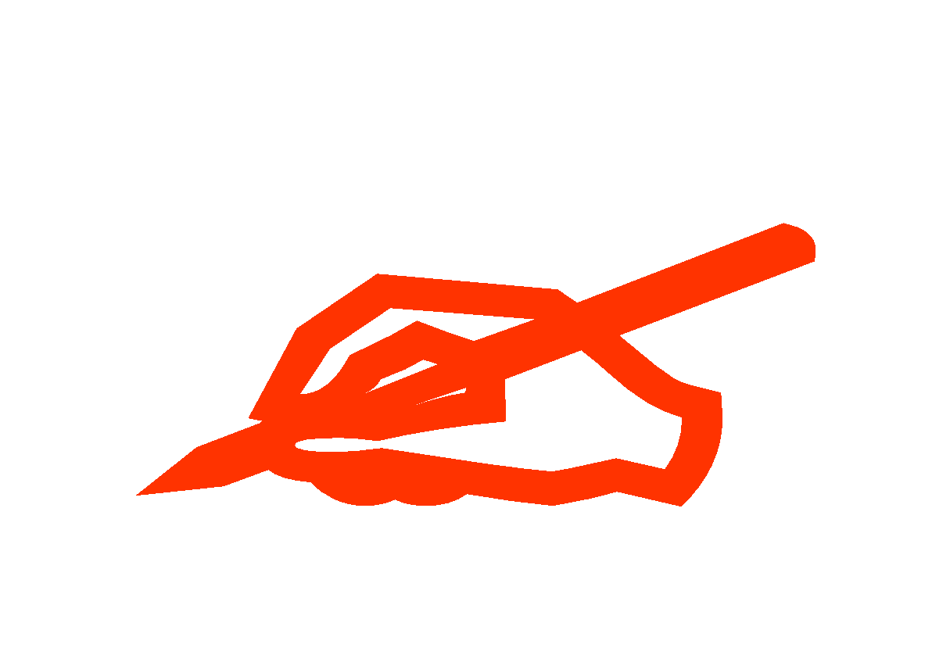
New words
take the second street
rẽ ở con đường thứ hai
BAKERY
HOSPITAL
RESTAURANT
FACTORY
TOY STORE
SUPERMARKET
BANK
SHOE STORE
MOVIE THEATER
DRUGSTORE
RESTAURANT
HOTEL
the second street
PARK
MARKET
SOUVENIR SHOP
POST OFFICE
STADIUM
POLICE STATION
SCHOOL
BOOKSTORE
MUSEUM

Slide 16
New words
take the third street:
rẽ ở con đường thứ ba
BAKERY
HOSPITAL
RESTAURANT
FACTORY
TOY STORE
SUPERMARKET
BANK
SHOE STORE
MOVIE THEATER
DRUGSTORE
RESTAURANT
HOTEL
PARK
the third street
MARKET
SOUVENIR SHOP
POST OFFICE
STADIUM
POLICE STATION
SCHOOL
BOOKSTORE
MUSEUM

Slide 17
MATCHING
1. tourist (n):
a. đi thẳng
b. rẽ ở con đường thứ hai
2. souvenir shop
3. go straight ahead
c. khách du lịch
4. take the first street:
d. rẽ ở con đường thứ ba
5. take the second street
e. rẽ ở con đường thứ nhất
6. take the third street
f. cửa hàng bán đồ lưu niệm

Slide 18
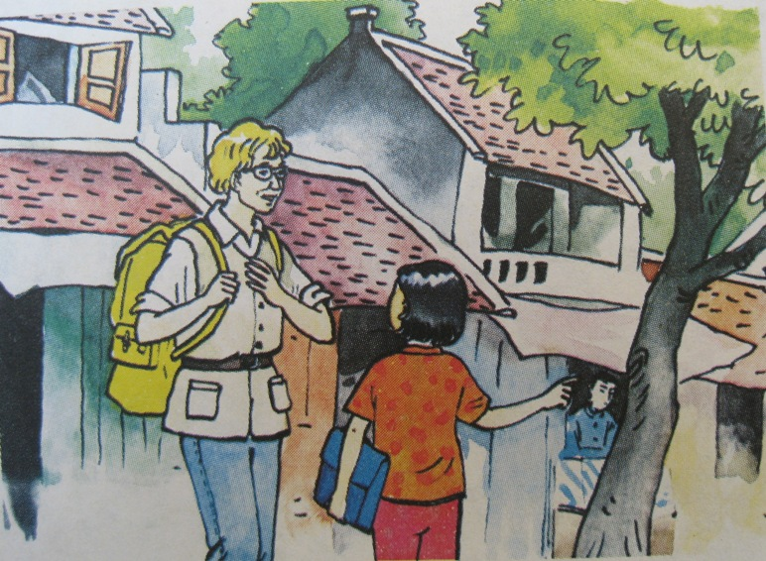
A2.Listen and repeat. Then practice the dialogue with a partner
1. Who are they?
2. Where are they?
3. Can you guess what they are talking about?

Slide 19
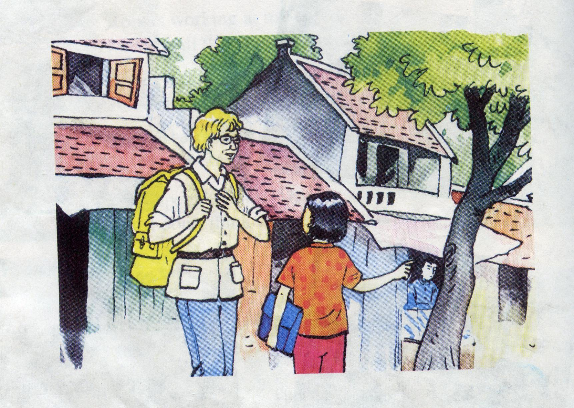
A 2.Listen and repeat. Then practice the dialogue with a partner
They are asking and answering about the way.
Tourist
Nga

Slide 20
A2. Listen and repeat:
a) Tourist: Excuse me. Is there a souvenir shop near here?
Nga: Yes. There is one on Hang Bai street.
Tourist: Could you tell me how to get there?
Nga: Go straight ahead. Take the second street on the left. The souvenir shop is on the right, opposite the post office.
Tourist: Thank you.
Nga: You’re welcome.
b) Tourist: Excuse me. Could you show me the way to the supermarket, please?
Nga: The supermarket? OK. Go straight ahead. Take the first street on the right. The supermarket is in front of you.
Tourist: Thanks a lot.
Nga: You’re welcome.

Slide 21


Listen and complete the dialogue
1
souvenir
a) Tourist: Excuse me. Is there a ...................shop near here?
Nga: Yes. There is one on Hang Bai Street.
Tourist: Could you tell me ..................to get there?
Nga: Go ..................ahead. ..................the second street on the left. The souvenir shop is on the right, opposite the post office.
Tourist: Thank you.
Nga: You’re welcome.
how
2
straight
Take
3
4
Could
b) Tourist: Excuse me..................... you show me the way to the supermarket, please?
Lan: The supermarket? OK. .................straight.............. Take the first street .....................the right. The supermarket is in front of you
Tourist: Thanks a lot.
Lan: You’re welcome.
5
Go
ahead
6
7
8
on

Slide 22
Remember:
1. Asking about the way:
A: Could you tell me how to get to the souvenir shop?
show
the way to the supermarket?
B: Go straight ahead. Take the first street on the left.
the second
right.
Could you tell / show me how to get to…?
the way to…?

Slide 23
Remember:
2. Giving directions:
- Go straight ahead.
- Take the first street on the left.
- It’s opposite / next to / between...and...

Slide 24
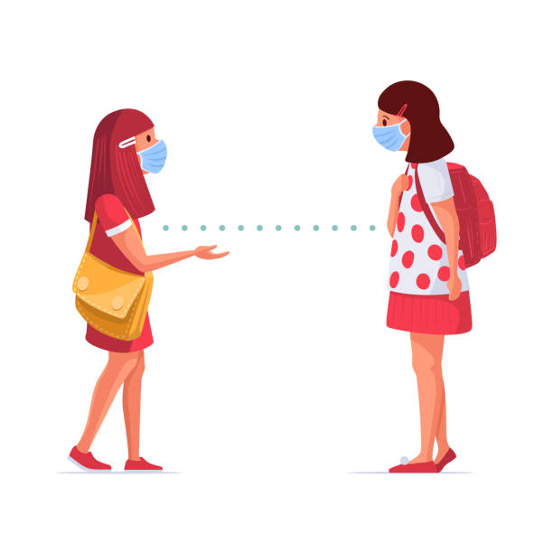
PRACTICE
01
02
03
04
05
06

Slide 25
Pratice the dialogue
a) Tourist: Excuse me. Is there a souvenir shop near here?
Nga: Yes. There is one on Hang Bai Street.
Tourist: Could you tell me how to get there?
Nga: Go straight ahead. Take the second street on the left. The souvenir shop is on the right, opposite the post office.
Tourist: Thank you.
Nga: You’re welcome.
b) Tourist: Excuse me. Could you show me the way to the supermarket, please?
Lan: The supermarket? OK. Go straight ahead. Take the first street on the right. The supermarket is in front of you.
Tourist: Thanks a lot.
Lan: You’re welcome.

Slide 26





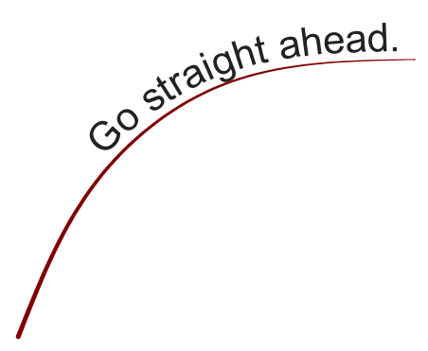
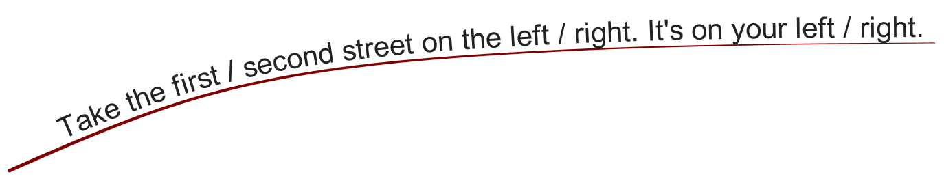

Could
you
tell
me
how to get to… ?

Slide 27
A3. Look at this street map. Practice the dialogue with a partner:
BAKERY
HOSPITAL
RESTAURANT
FACTORY
TOY STORE
SUPERMARKET
BANK
SHOE STORE
MOVIE THEATER
DRUGSTORE
RESTAURANT
HOTEL
PARK
MARKET
SOUVENIR SHOP
POST OFFICE
STADIUM
POLICE STATION
SCHOOL
BOOKSTORE
MUSEUM

Slide 28
Nga: Where is the bank?
Nam: The bank is between the hotel and the restaurant. It’s opposite the hospital.
01
Example:
02
03
04
05
06

Slide 29
HOMEWORK
Learn new words and grammar by heart
Do all the exercises
Prepare for the next lesson: Unit 8 – B

Slide 30
Thanks for your attention!

